Slide 1
DATA SCIENCE
PROJECT-AIRBNB
TEAM:
S S PRIYA
SADHVI SUSHRAVYA H S
SATHI SREYAHSRI
SEJAL PRIYA

Slide 2
DESCRIPTION OF DATASET :
Our dataset is on the data collected from different tourist spots about the accomodation facilities present in that area.
This dataset, that we’ve used is from Airbnb which is a vacation rental online marketplace company originally based in San Francisco and is now making great progress by also having branches in cities like New York, Tokyo, Singapore, Seattle etc.
The dataset is from Singapore that contains data like the name of the Airbnb i.e., the lodging or the homestay, the name of the host, the ID that is given to the host, etc.
The data from Airbnb also gives information about the neighbourhood and also the latitude and longitude of the place, that reduces the burden of worrying about the directions to the place from the shoulders of the customer.
Our dataset contains a total of 16 columns where each of the column represent the different attributes like name, ID, cost etc.
It has the information of about 7907 places of accomodation which shows the growth of a 12 year old company into a successful one.
There are a few empty cells where we can see the absence of any data regarding that attribute. There are 5518 empty cells for a total of 126528 cells which makes the percentage of empty cells 4.361%.
The dataset also has,
categorical variables(name, host name etc)
discrete variables(ID, host ID etc)
continuous variables(latitude and longitude)

Slide 3
EXPLORATORY
DATA ANALYSIS

Slide 4
COLUMNS IN DATASET :
Consists of 16 columns and 7907 rows with almost 5518 null values
ID - A unique code of the location of the Airbnb
HOST_ID - An ID provided to each host of AirBnb
LATITUDE - Latitude of the AirBnb Location
LONGITUDE - Longitude of the AirBnb Location
PRICE - Cost per night in the room
MINIMUM_NIGHTS - Minimum duration of stay
NUMBER_OF_REVIEWS - Reviews available for a particular location
LAST_REVIEW - Date of the last review of the AirBnb
REVIEWS_PER_MONTH - Number of user reviews per month
CLACULATED_HOST_LISTING_COUNT - Number of total customers who have stayed in a particular AirBnb
AVAILABLITY_365 - Number of days available in the year
NAME- Name of the AirBnb
HOST_NAME- The owner of the AirBnb
NEIGHBOURHOOD_GROUP - The region the AirBnb is located
NEIGHBOURHOOD - Name of the locality of the AirBnb
ROOM_TYPE - Type of room ( private / shared / whole apartment or house)
6 of the columns have categorical values
10 of the columns have numerical values.

Slide 5
DATA CLEANING
Handling missing data by
Dropping and imputing
Fixing the typos and inconsistent capitalization.
STEP 2
STEP 1
STEP 3
Removing unwanted observations
Exploratory Data Analysis(EDA) is an approach for analyzing data sets to summarize their main characteristics, often with visual methods.

Slide 6
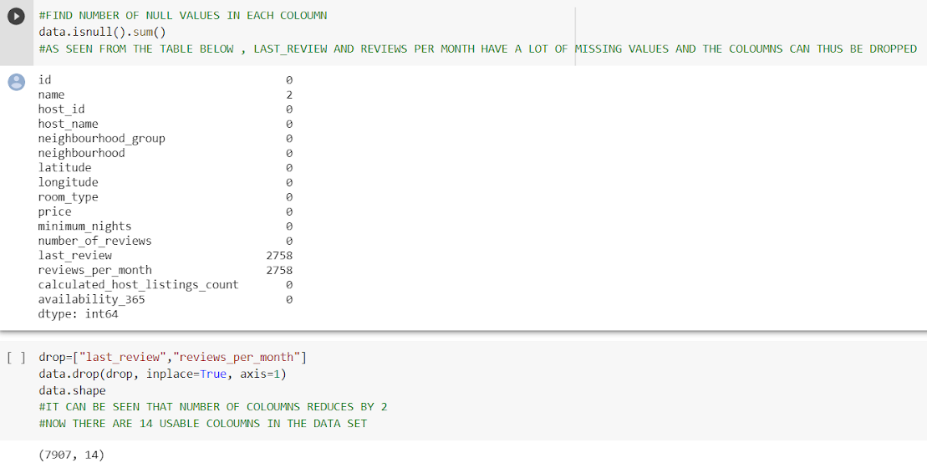
We find the empty cells
Remove unwanted ones if any.
DATA CLEANING:
DATA CLEANIG

Slide 7
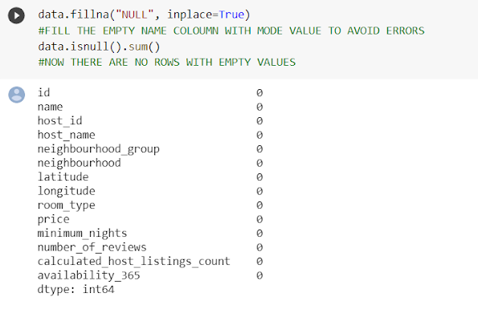
3.We now fill empty categorical column i.e “name” filled with null
We see no row with empty values

Slide 8
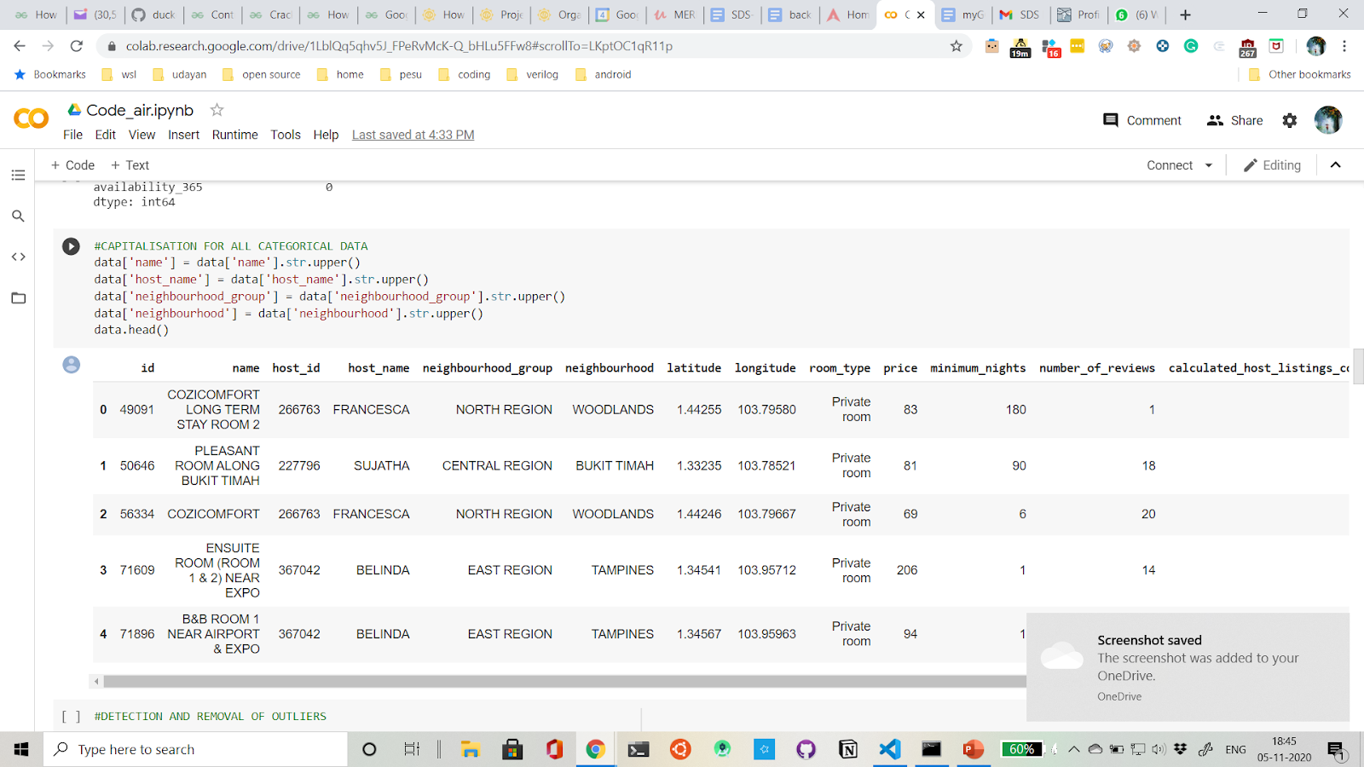
4. To make our dataset consistent we decided to capitalize all categorical data
NEPTUNE
MARS
VENUS
SATURN
It’s the farthest planet from the Sun
Despite being red, Mars is a cold place
Venus is the second planet from the Sun
It’s composed mostly of hydrogen and helium

Slide 9
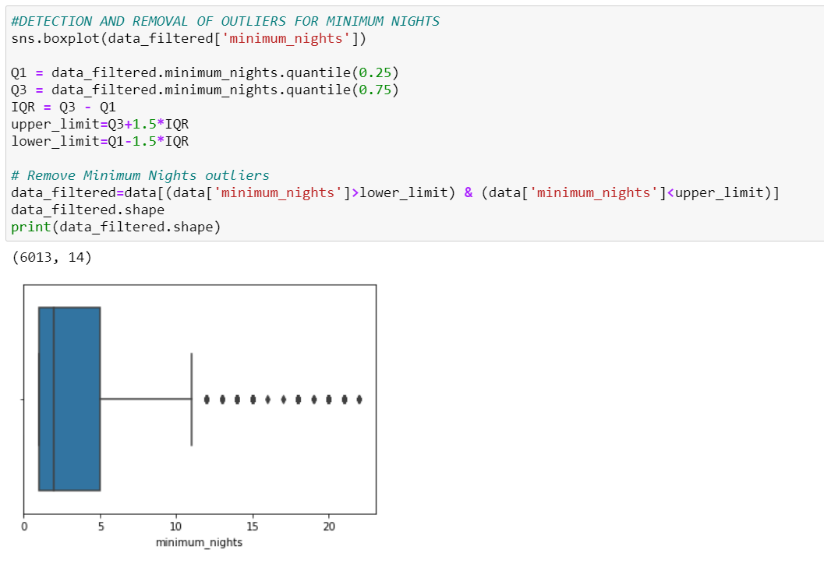
COMPANY
01
You could enter a subtitle here if you need it

Slide 10
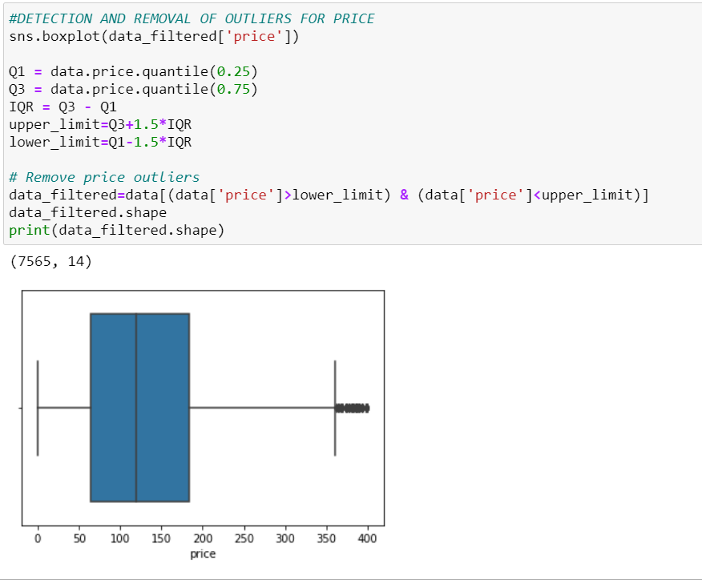
COMPANY
01
Using Box plot we detected that there are a number of outliers which need to be filtered.
Then we filtered it using the IQR formula
You could enter a subtitle here if you need it

Slide 11
GRAPH VISUALIZATION

Slide 12
Four graph visualization techniques
BOXPLOT:
It represents a box the middle line represents median, left or the bottom -1st quartile and
right or top-3rd quartile. Left whisker contains min value. Right whisker contains max value.
They also shows any outliers if present.
SCATTERPLOT:
Depicts the cartesian coordinates for two variables. Uses dots to represent values for different variables.
BARCHART:
Presents categorical data with rectangular bars with heights or lengths proportional to the values that they represent.
HISTOGRAM:
Representation of distribution of numerical data, it represents frequency of continuous data

Slide 13
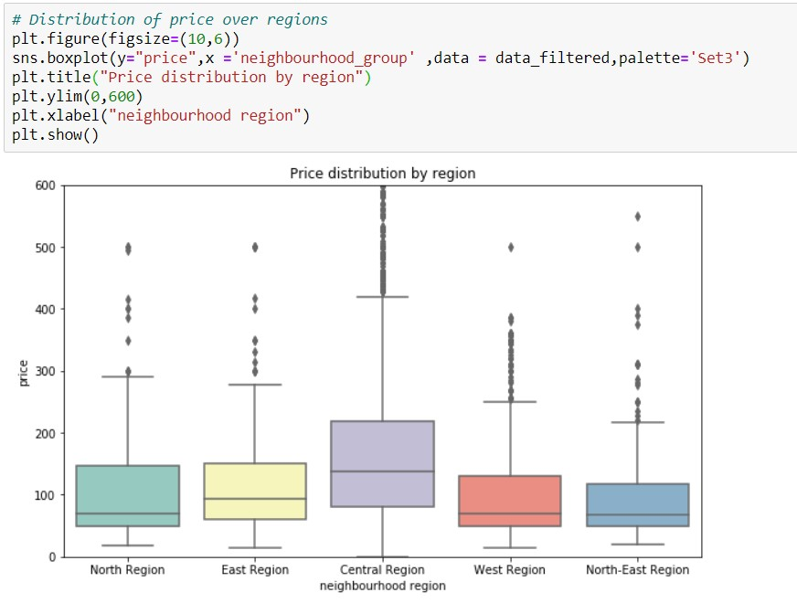
BOXPLOT :
NEPTUNE
SATURN
Here to visualise distribution of
price over the regions
1.The price feature in general is positively skewed over all regions.
2.Minimum price of rooms is almost same for all regions
3. The central region also shows the maximum range in prices while the north east region shows the least.
It’s the farthest planet from the Sun
Saturn is composed of hydrogen and helium

Slide 14
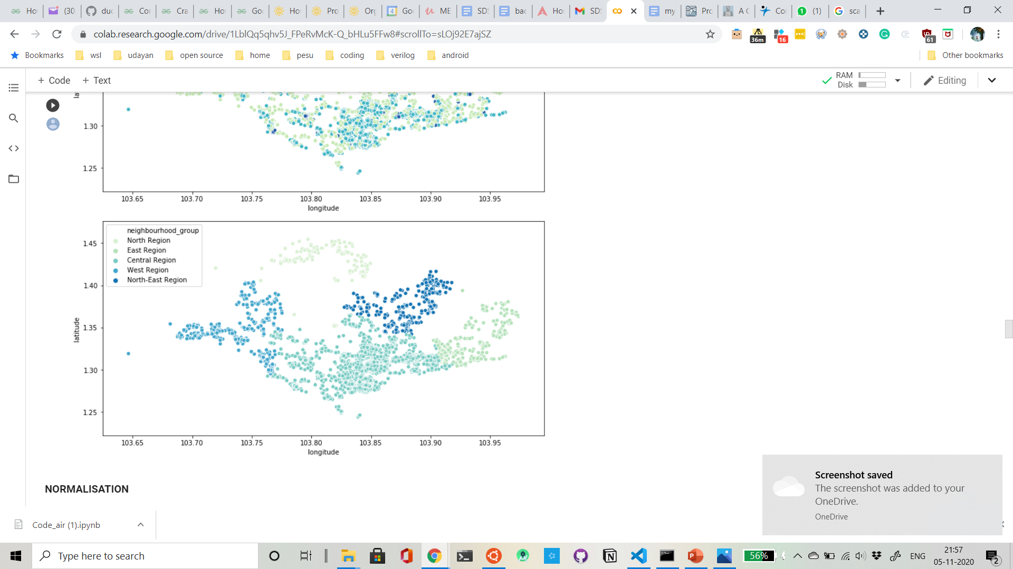
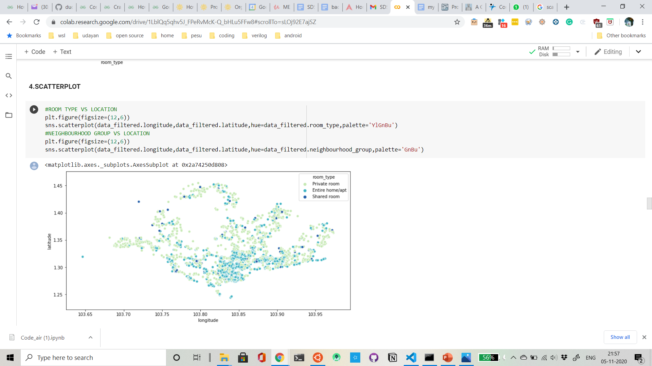
SCATTER PLOT:
JUPITER
SATURN
NEPT
JUNE 2
OCTOBER 14
JANUARY
Visualisation of
Neighbourhood
Group vs
location
Central region covers the largest area.
north -east region has the least.
It’s the biggest planet in the Solar System
Saturn is composed mostly of hydrogen and helium

Slide 15
Visualisation of Room type vs location
1.home/apt type are present in more number
2.shared room type are barely present and are spread throughout the concerned region.
3.private rooms are present in comparatively larger numbers and are spread out almost throughout region.
4. Rooms in general are absent or very less in number in the leftmost top and bottom of concerned region.

Slide 16
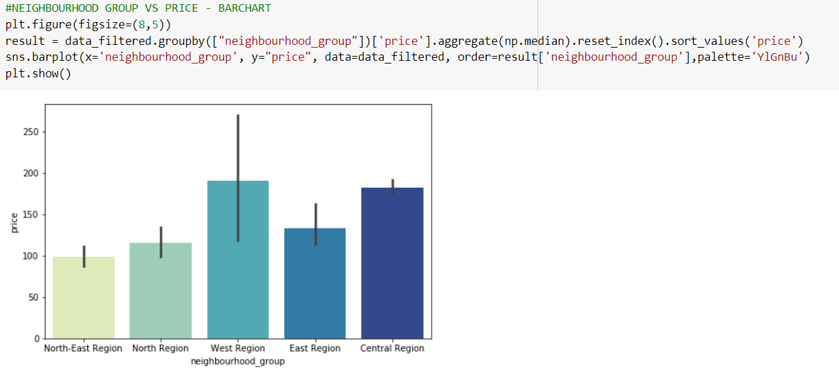
BARCHART:
Visualisation of
neighbourhood group vs price
The lines represent error intervals. Which represents confidence/ standard deviation. Seaborn takes the avg by default.
The bars here indicate the the neighbourhood groups
Though west region might have the maximum number
Minimum price
But as the standard deviation is more compared to central region.
so we can conclude that it is maximum for the central region and not west region

Slide 17
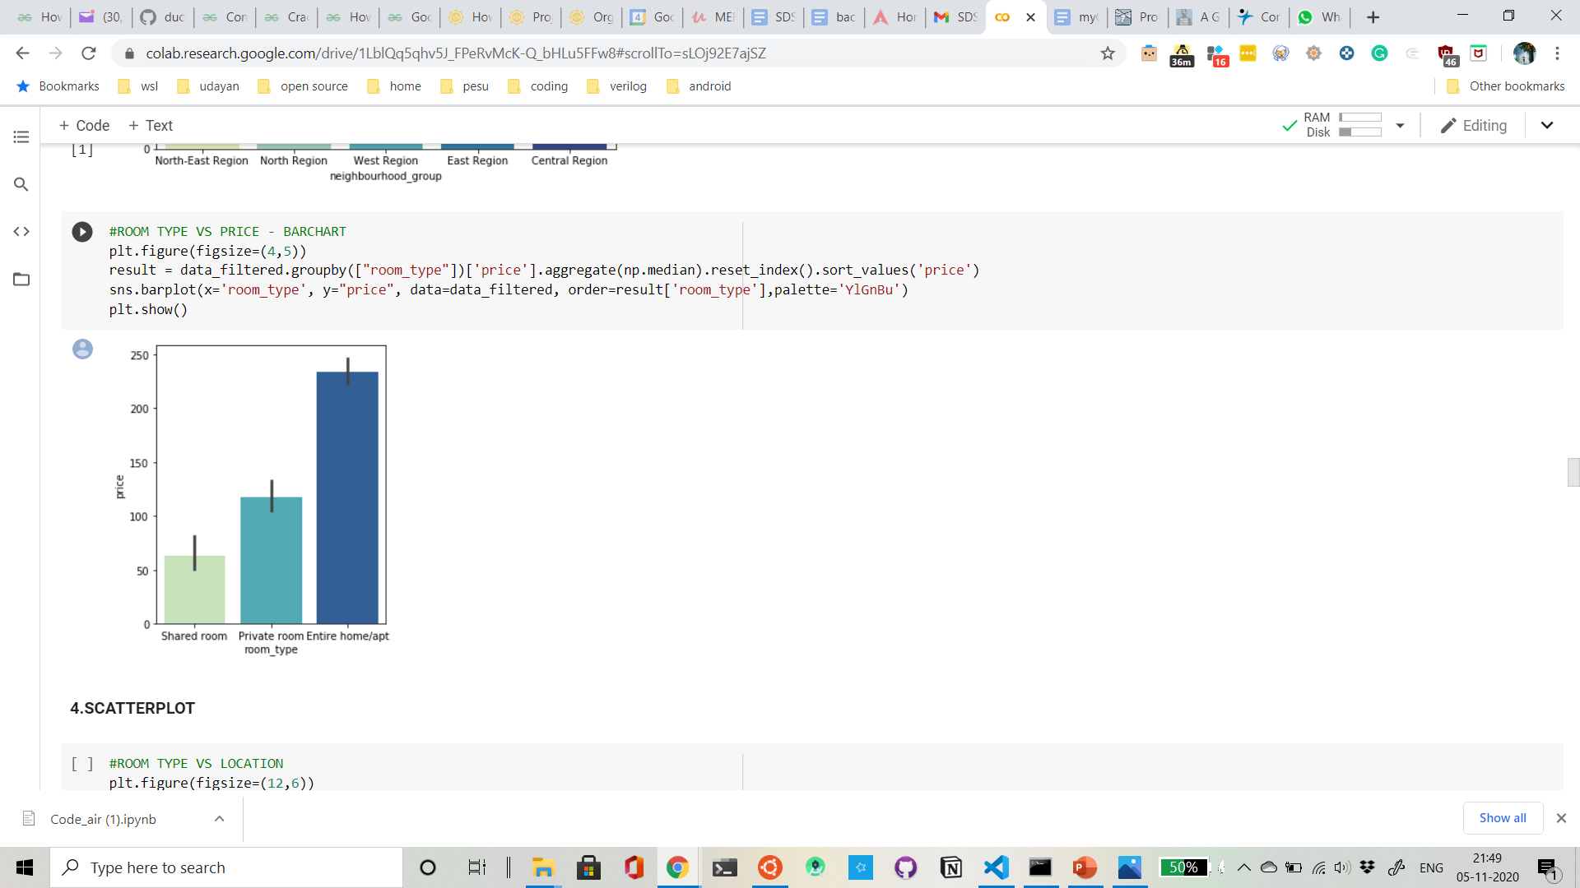
Visualisation of Room type vs
Price
The price for entire home/apt type is the maximum while that for
shared rooms is the least.

Slide 18
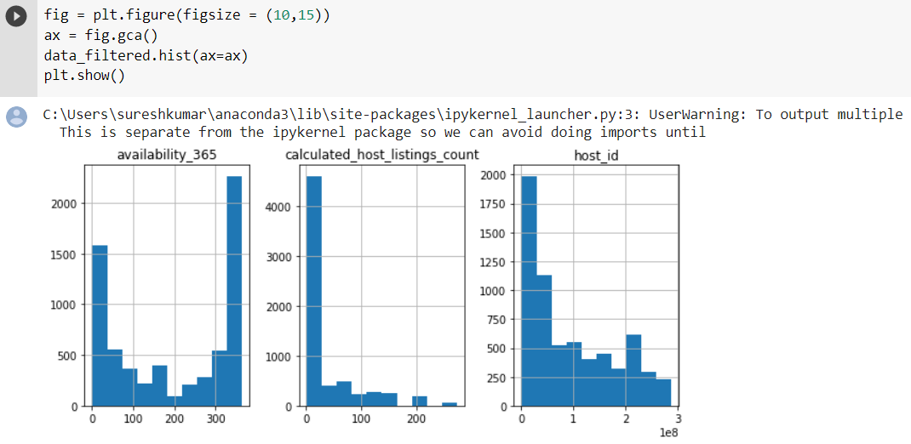
HISTOGRAM:

Slide 19
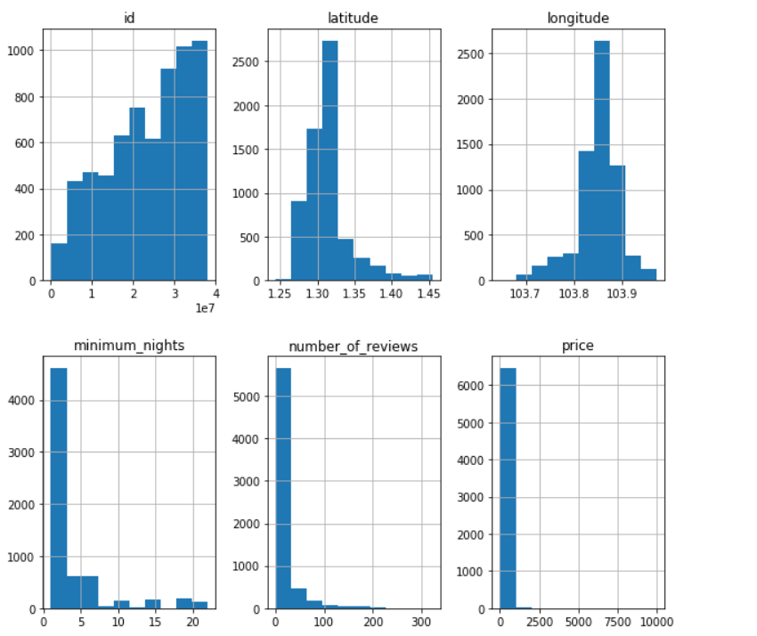

Slide 20
NORMALIZATION
AND
STANDARDIZATION

Slide 21
Steps involved in normalization:
1.Computing mean and variance for all columns
2.Normalizing all numerical columns to make mean 0 and variance 1
3.Using graphs to check if data is normal
Why is normalization needed? How does it affect dataset?
The goal of normalization is to change the values of numeric columns in the dataset to a common scale without distorting differences in the ranges of values.Standardizing the features around the center with mean 0 and a standard deviation of 1 is important when we compare measurements that have different units. When we want to analyze data that has more than one variables, which are measured using different scales, analysis without having a common center at zero and then scaling them down can cause bias. Variables with wider scale ranges can outweigh those which vary over a smaller range.

Slide 22
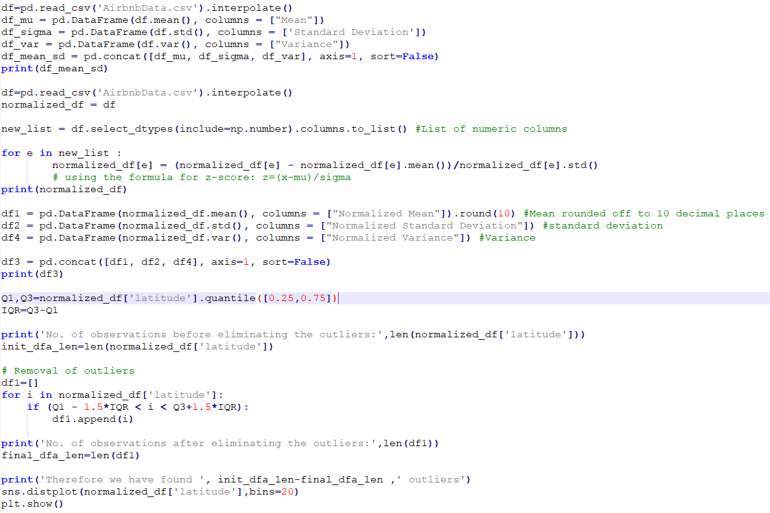
Code implementing the above mentioned steps

Slide 23
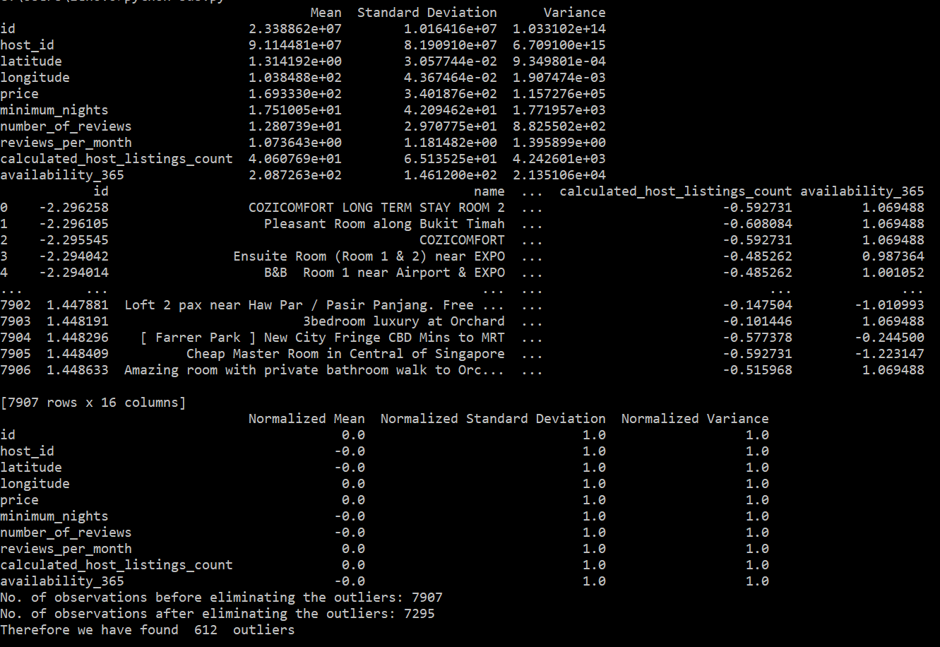
Output showing the mean, variance and standard deviation for all numerical columns before and after being normalized

Slide 24
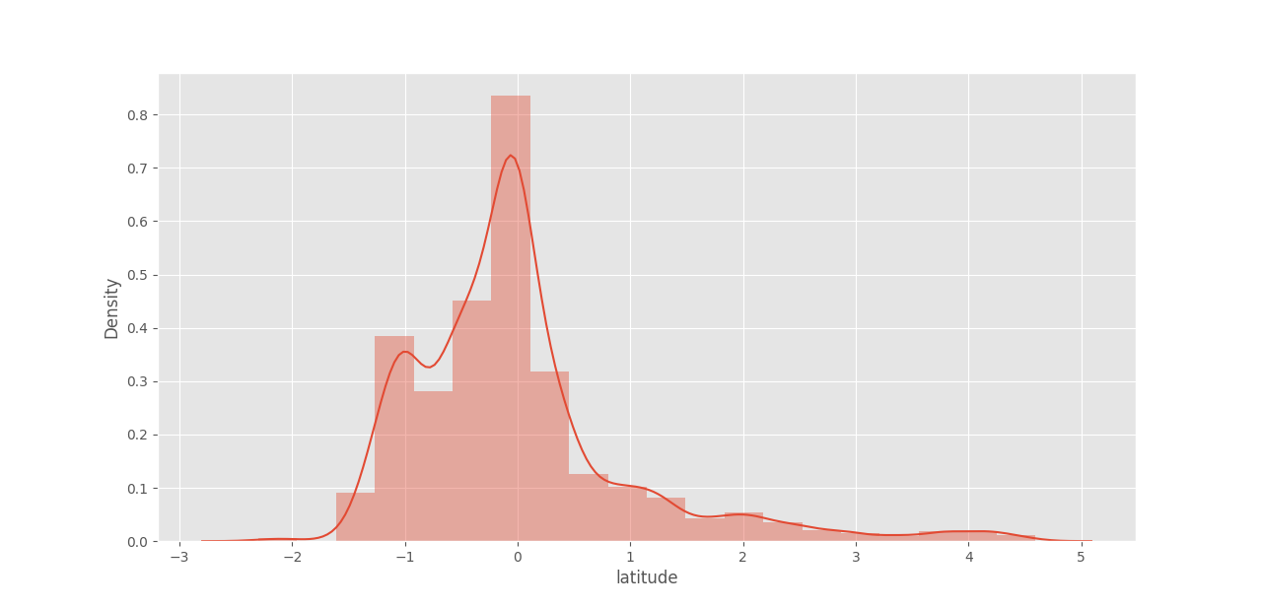
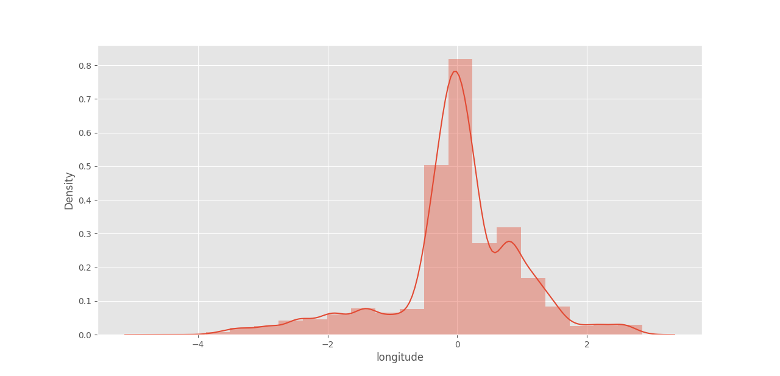
Graphs for Latitude and Longitude after
normalization show normal distribution

Slide 25
HYPOTHESIS TESTING

Slide 26
Hypothesis testing in statistics is a way to test the results of a survey to see if we get meaningful results. So basically we are testing our results by figuring out the odds that happen by chance.
Consists of 2 types of hypotheses:
H0(Null hypothesis): Is usually the sample observations result purely from chance
H1(Alternate hypothesis): Is the hypothesis that sample observations are influenced by some non-random cause
While performing the hypothesis test:
We put the null hypothesis on trial
We begin by assuming that H0 is true
The random sample provides the evidence
The hypothesis test measures the strength of disagreement between the sample and H0

Slide 27
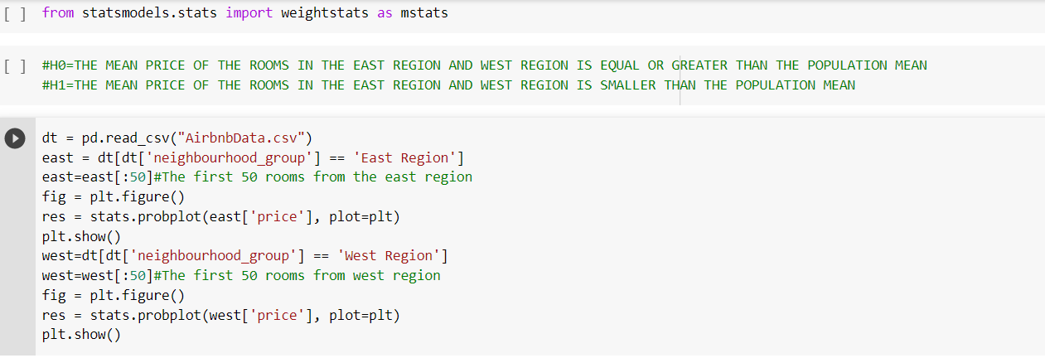
We assumed that
H0(Null Hypothesis) is the mean price of rooms in east and west region is greater than or equal to the population mean
H1(Research Hypothesis) is the mean price of the rooms in the east and west region is smaller than the population mean

Slide 28
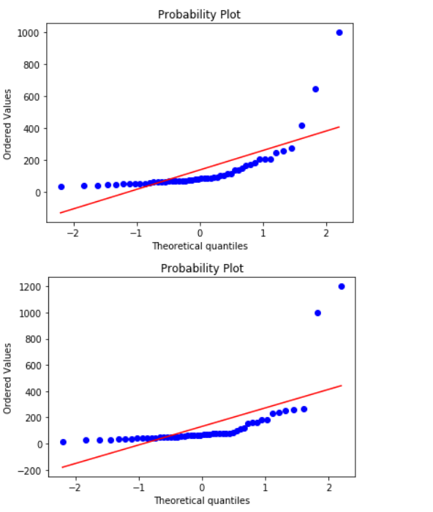
Probability plot is a graphical technique to identify substantive departures from normality.The data are plotted against a theoretical distribution in such a way that the points should form approximately a straight line.
The upper graph shows the probability plot of the Eastern region.
The lower graph shows the probability plot of the Western region.

Slide 29
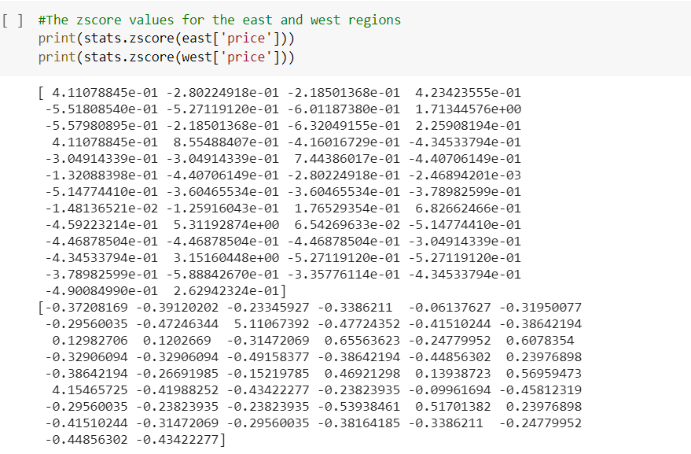
Z-Score is a statistical measurement of a score's relationship to the mean in a group of scores.
It simply gives the idea of how far a value is from the mean.
The value of Z, for Z-score can be known by the formula,
Z= (x-μ)/𝛔
Where, Z- Z-score
x- Test score
μ- Population mean
𝛔- Population Standard Deviation

Slide 30
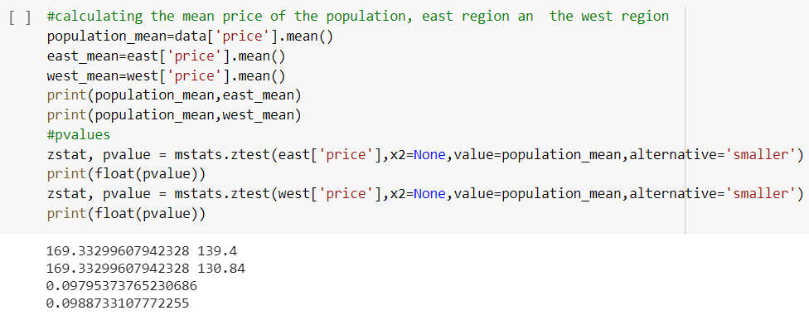
Decision on whether the null hypothesis is supported or rejected:
5% statistical significance
So, since P-value(observed significance level) is greater than 0.05, (taking at 5% statistical significance), we do not reject H0, the original hypothesis, and continue with the accepted fact i.e. the null hypothesis
Therefore, we can confidently conclude that the null hypothesis is plausible.

Slide 31
CORRELATION
Correlation is a statistical measure that expresses the extent to which two variables are linearly related (meaning they change together at a constant rate). It’s a common tool for describing simple relationships without making a statement about cause and effect.

Slide 32
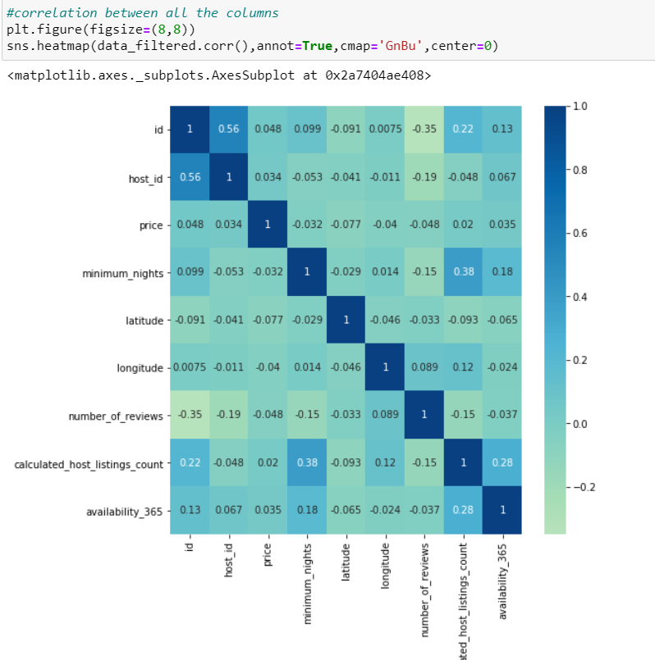
Heatmap showing the correlation between all the columns in the dataset.
We notice that the deeper the color the more is the correlation

Slide 33
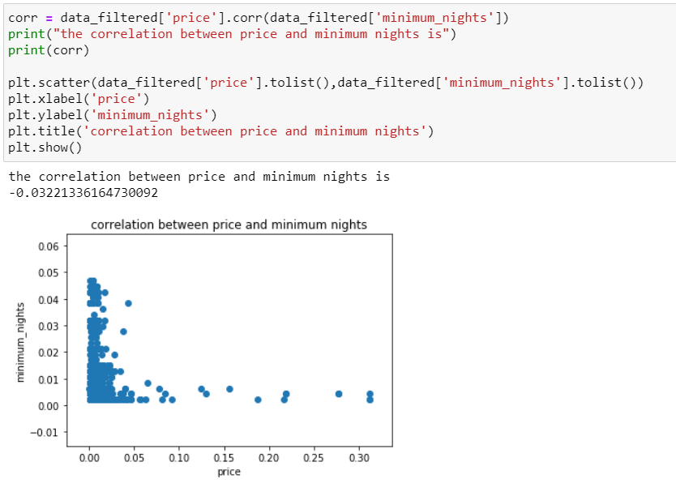
Here is a correlation between price and minimum nights using a scatterplot
The correlation between price and minimum nights is
-0.03221336164730092
The negative value shows that price of a room per night and the minimum nights for which a room in a hotel can be booked are negatively related as hotels with longer stay provide cheaper per night stay price.

Slide 34
INFERENCES
1.Our dataset is collected from hotels in Singapore commissioned by Airbnb which were last reviewed between 2013 and 2019 and serves as a sample of data from a larger population of all hotels in Singapore(commissioned by Airbnb or otherwise).
2. While cleaning our dataset we found some outliers in price and minimum_nights column, we removed the outliers when the value is between upper and lower limits for each column.
3.The range of price in our dataset is 0 to 10000 and that of minimum nights is 1 to 1000 and obviously both are measured in different scales so if we would not have normalised or standardised the data, price would have dominated the prediction for our model which involved both variables.And hence the importance of normalization of data is seen.
4. The value of the Null hypothesis being greater than 0.05(0.0979 for the East Region and 0.0989 for the West Region) shows that it cannot be rejected and both Null and Alternate Hypothesis are plausible.
5.A negative correlation between price per night and minimum number of nights for which booking can be done was found showing that price of a room per night and the minimum nights for which a room in a hotel can be booked are negatively related as hotels with longer stay facility provide cheaper per night stay price.
Conclusion: We determined how the price for the hotel varies according to the minimum nights booking required by the hotel and also according to the region of the hotel

Slide 35
THANK YOU

